Slide 1



Slide 2
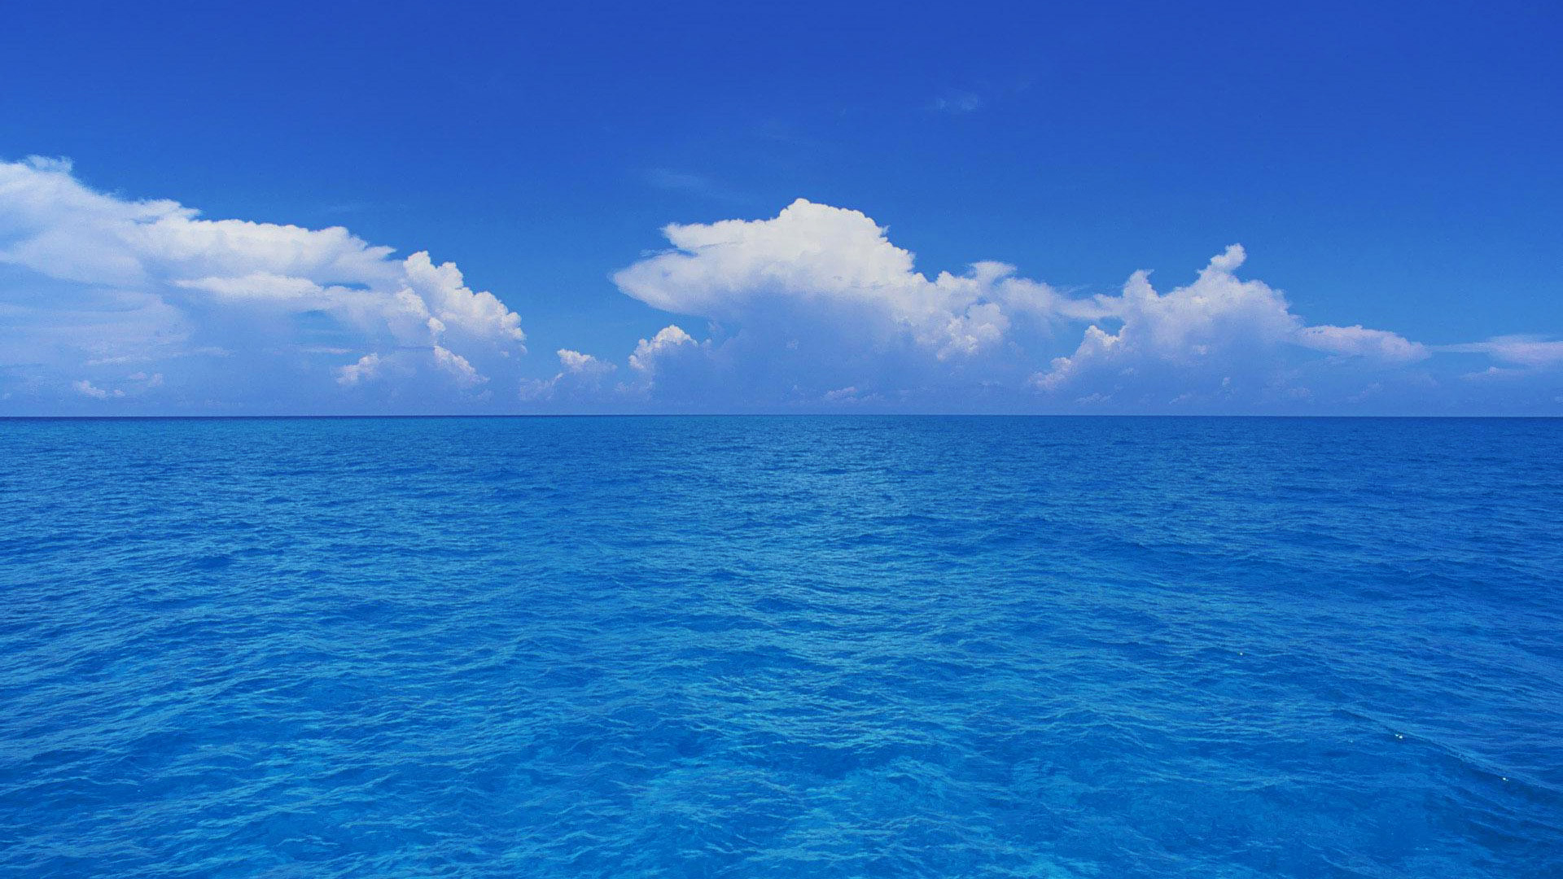

You think this is beautiful?
under the surface it is a diferent story.....

Slide 3
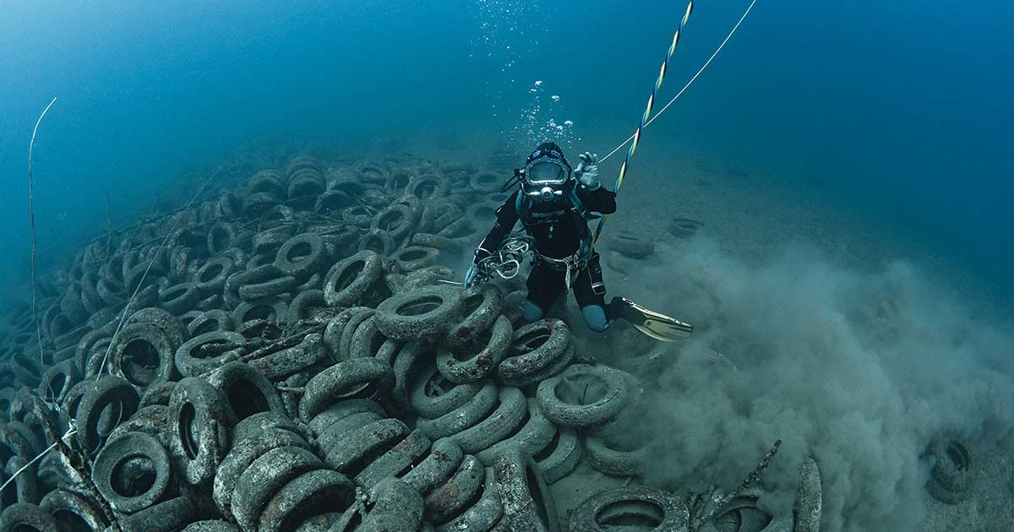

Slide 4
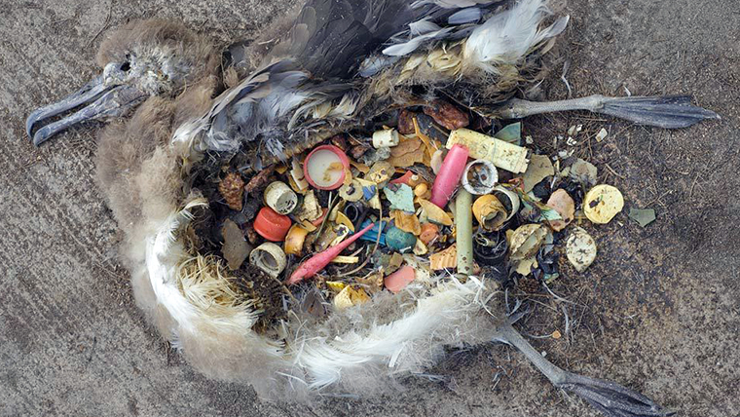

Slide 5
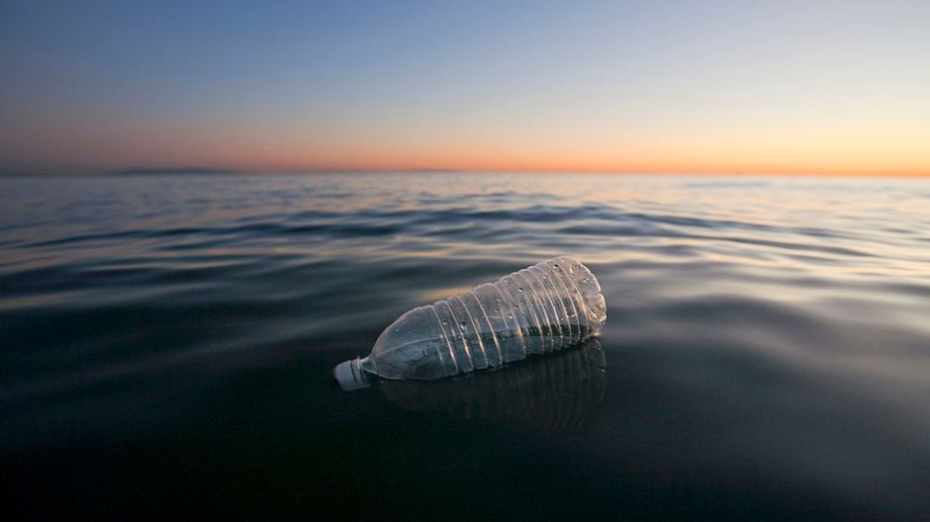

Slide 6


